Slide 1
Capstone Project
Credit Card Fraud Detection using Machine Learning
Name : Mugdha Kulkarni

Slide 2
Flow of Talk
Introduction
Experimental Setup and Method
Performance Evaluation and Result
Conclusion
Reference

Slide 3
Introduction
Fraud can be defined as criminal deception with intent of acquiring financial gain.
Credit Card Fraud
Inner Card fraud:-Done by using false Identity
External Card Fraud:-Done by Using stolen credit card
How Frauds are Recognized
Location
Items you buy
Frequency
Amount

Slide 4
Challenges
The data is highly skewed.
Normal Machine learning algorithms would give 99% +Accuracy.
But we can get 99.8% accuracy even if we classify all frauds as legitimate.

Slide 5
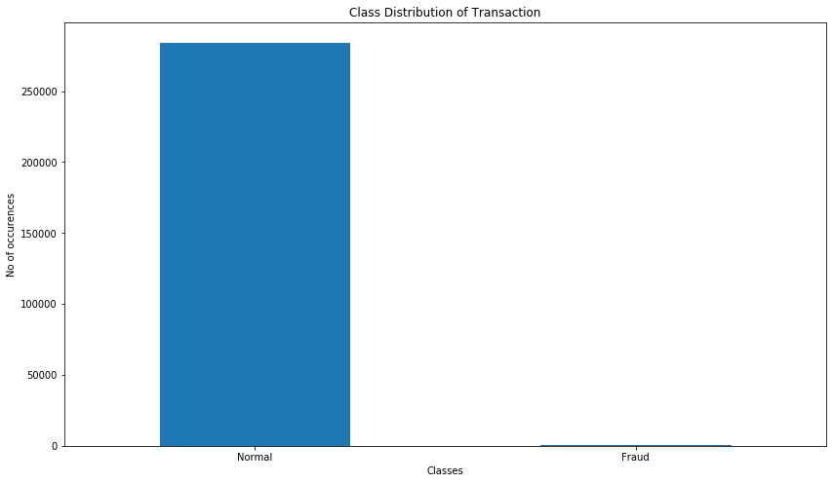
Exploratory Data Analytics

Slide 6
Experimental Setup and Method
Dataset :
Sourced from Kaggle Machine Learning Group.
Consisting 2,84,807 transactions, and in that (632) 0.172% fraud cases.
Highly unbalanced and skewed towards fraud class.

Slide 7
Algorithm Applied
Decision Tree Classifiers :
The Decision Tree algorithm is a supervised machine learning algorithm used for classification and regression tasks.
The algorithm’s aim is to build a training model that predicts the value of a target class variable
We just received 99.92% accuracy in our credit card fraud detection.

Slide 8
K-Nearest Neighbor Algorithm
We have built the model using the K-Nearest Neighbor Algorithm and mentioned the ‘n_neighbors’ to be ‘7’.
The value of the ‘n_neighbors’ is randomly selected but can be chosen optimistically through iterating a range of values, followed by fitting and storing the predicted values into the ‘knn_yhat’ variable.

Slide 9
We can also evaluate on the below algorithms
Random Forest and Logistic Regression
Performance of naïve bayes, K-nearest neighbour and logistic regression classifier are evaluated based on:
Accuracy
Sensitivity
Specificity
Precision

Slide 10
Conclusion
In this machine learning project, we build K-Nearest Neighbor Algorithm and Decision Tree classifiers and see which one works best.
The Decision Tree algorithm is a supervised machine learning algorithm used for classification and regression tasks.
The algorithm’s aim is to build a training model that predicts the value of a target class variable
We just received 99.94% accuracy in our credit card fraud detection.
This number should not be surprising as our data was balanced towards one class.
when we round up the results of each model, it shows 0.99 (99% accurate) which is a very good score.
We have seen that KNN algorithm is best for this fraud detection.

Slide 11
Thank-You

